Slide 1


Apple is a Catalyst in Everyday Innovation
By: Daiel Genzale

Slide 2
01
iPhone
Apple’s Innovative Products Amongst the Culture
02
Apple Watch
03
Airpods

Slide 3





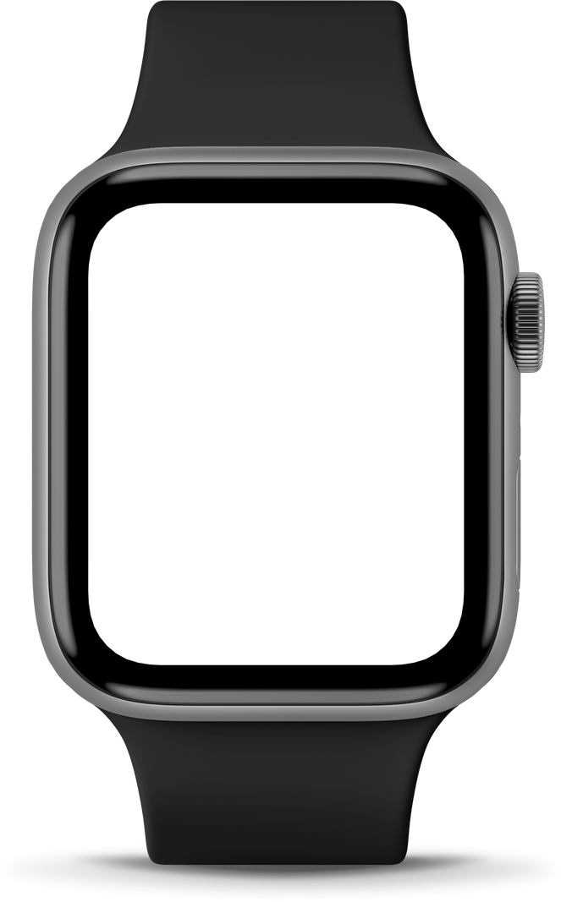

History on Apple
Apple has been dominating the world of technology ever since they launched back in July 1976.
Steve Jobs and Steve Wozniak - founders
First iPhone launched - June 29, 2007
First Apple Watch launched - April 25, 2015
First Airpods launched - December 13, 2016

Slide 4
Announced Jan 9, 2007; released June 29, 2007. Sold 1 million units in 7 weeks, sold about 2 million in the first year.
iPhone Culture
Innovative Success
When Apple first released the iPhone it shaped culture significancy and made it huge in the world of technology. Today it is dominating the smartphone culture, while fostering user loyalty through innovation, security, and continuous updates.
Holds 61% of the U.S. smartphone market as of 2024. iPhone users spend more time on devices and are loyal to the company, often keeping phones for 2+ years.
The iPhone is a groundbreaking device that reshaped technology, media, communication, and daily life worldwide.

Slide 5
Catalyst to the Culture
iPhone Significance
01
Transformed communication, work, and media consumption. Introduced features like Messages, FaceTime, and the App Store for easy access to apps.
03
Able to gain trust throughout the years. IOS is able to secure data recovery and privacy.
04
Influencers and celebrities prioritize the use of an Apple smartphone. (All over social media)
02
Continually updated in size, display, features, and functionality. Over 3 billion iPhones sold globally to date.

Slide 6

Announced in September 2014, and released on April 24, 2015. Sold 81.2 million units from 2015 to the end of 2024
Access anything, just from your Wrists
In the US, around 59% of smartwatch/fitness tracker users have an Apple Watch, and nearly 80% of Apple iPhone owners also own an Apple Watch.
From phone to watch
The apple watch is a smartwatch that allows one to track their health, productivity, and fitness journey.
The Apple Watch changed the way people track their fitness goals, health, and journey.

Slide 7
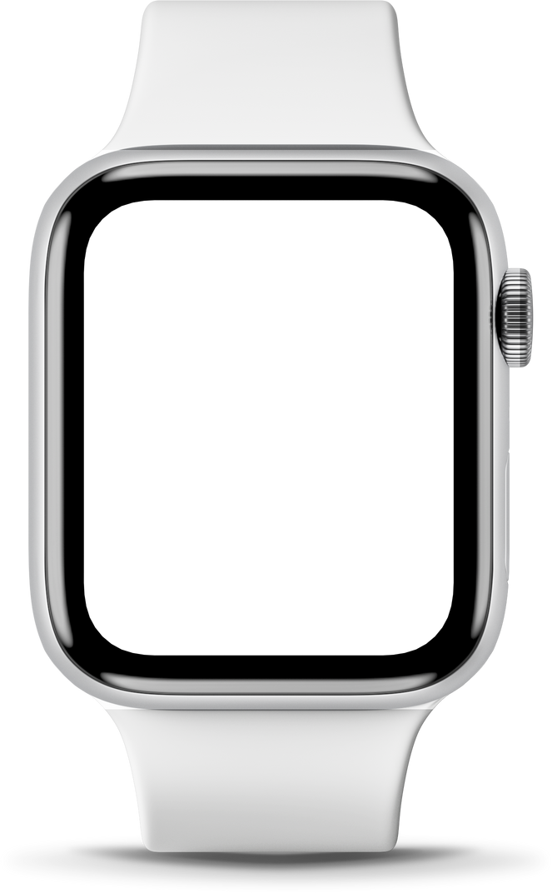

Apple Watch is a Dominate Device in the World of Fitness
03
Apple gives in trust to users by allowing calls and payments from the wrist. The watch also encourages users to “Stand” and take deep breaths, making users more inclined to interact and indulge in a healthier lifestyle.
Apple Watch Significance
04
People favor the Apple Watch because it helps them reach health goals and monitor their ECG, which is perfect for those with heart rhythm problems. New models include sensors for glucose, oxygen levels, and sleep, making the watch a major catalyst of innovation for people with health issues. Loved by millions, it can even save lives with its easy-to-use emergency SOS feature that alerts police, family, or friends when needed.
01
The Apple Watch is loved by many users in the Apple world. Its users stretch from teens and elders who enjoy using their watch for everyday task such as step tracking, fitness goals, and even health measures.
02
The Apple Watch works in fitness and health, but also handles communication, payments, and productivity on the daily. The watch uses voice commands with Siri and hands-off operations.

Slide 8
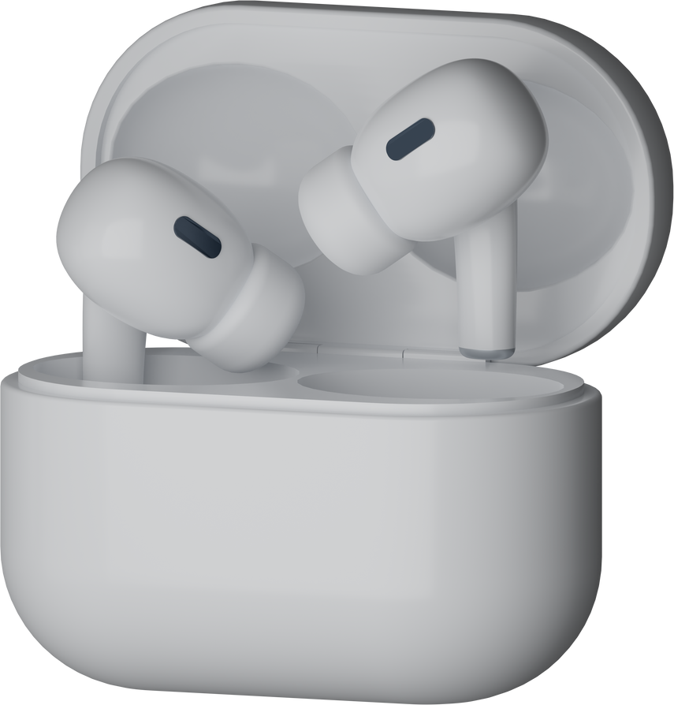
AirPods were released on December 13, 2026. Throughout the years, different generations of the earpods had been released, e.g. AirPods Pro, and later models, were released on different dates throughout the following years.
AirPods Catalyst
Better Listening
According to analysts, Apple’s AirPods holds around 60% of the global wireless headphone market, demonstrating their strong industry presence and success.
Apple’s bluetooth earpods, known as the Airpods, is a significant catalyst in the world of listening to music and hearing.The AirPods are a staple in the Apple ecosystem and used by millions.
AirPods are loved by millions. Not only are they great for listening to music with diffrent sterio features, but Apple was able to make features that allow everyone, esspecially people who are hard of hearing to enjoy AirPods as well!

Slide 9
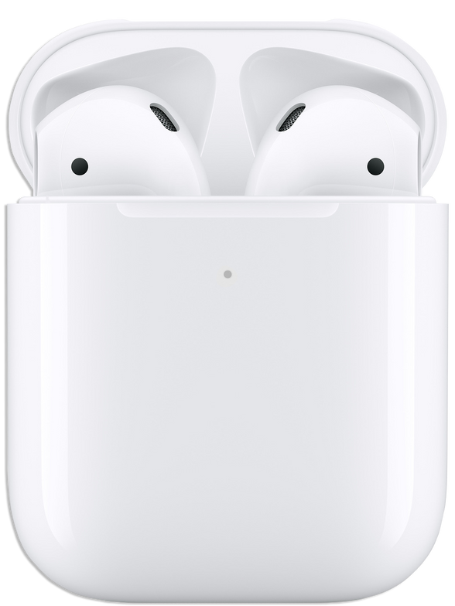
AirPods and their Universial uses
02
Apple added hearing assistance features in the latest AirPods, including transparency mode to amplify sound and reduce background noise, plus customizable audio settings for high and low frequencies.
AirPod’s Significance
Apple’s bluetooth earpods, known as the Airpods, is a significant catalyst in the world of listening to music and hearing.The AirPods are a staple in the Apple ecosystem and used by millions.
03
The automatic noise reduction feature reduces background and atmospheric noise, prioritizing speech clarity in crowded environments. AirPods also integrate with the Health app to monitor loud noise exposure and adjust settings automatically. Another feature, Live Listen, uses the iPhone as an enhanced microphone to make conversations clearer in noisy environments.
01
First launched in 2016, Apple was able to target main issues and goals that people were wanting. From changing songs with a tap to hearing aid features, AirPods connected with millions in the culture. They did more than play music; Apple made it easy for people with hearing disabilities to engage in conversations in loud environments.
04
Another feature of AirPods is the built-in hearing test, which assesses hearing levels and creates personalized audio settings. This helps people with hearing disabilities use headphones and communicate more easily in noisy environments by reducing background noise.

Slide 10
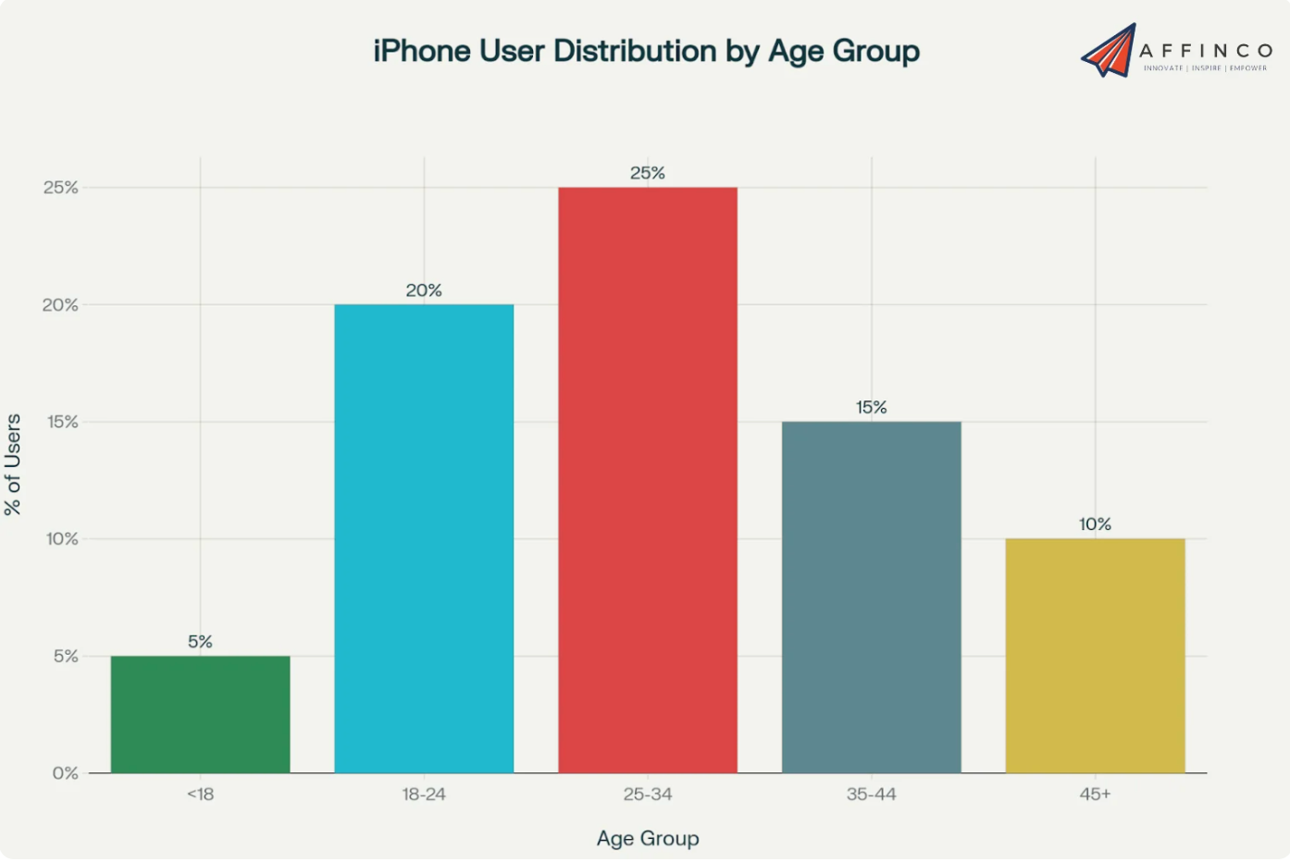

Slide 11
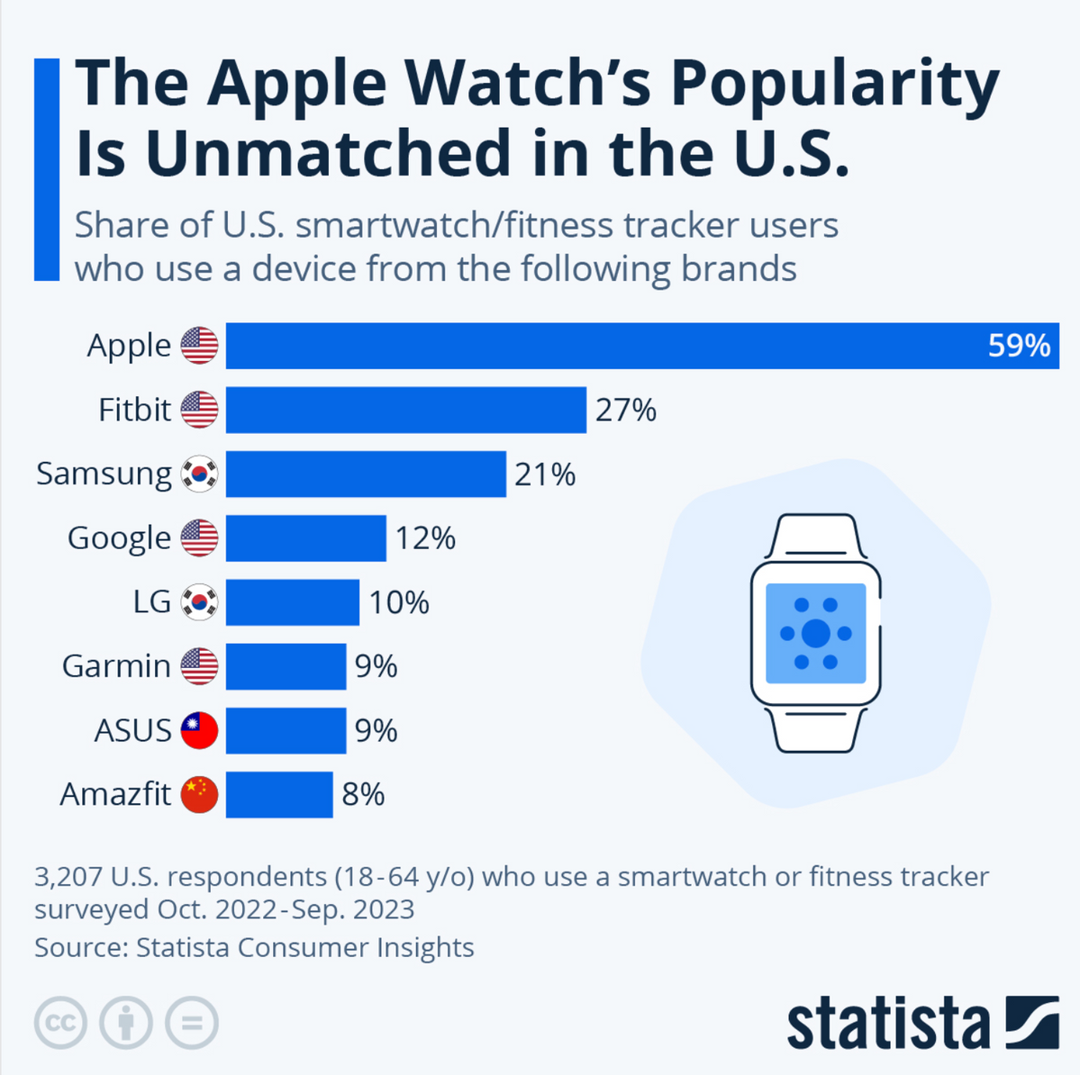

Slide 12
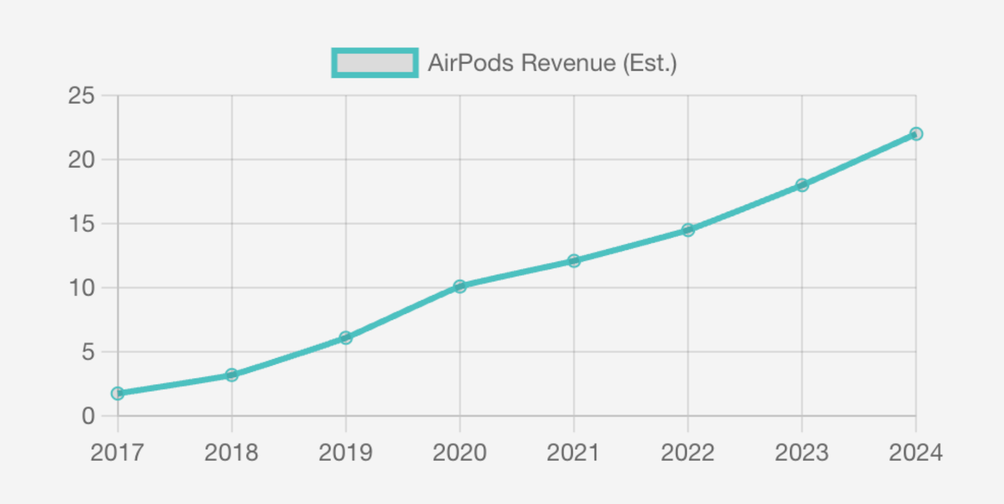

Slide 13
Thank You
Presentation References:
“How Many Airpods Sold Yearly? 2017-2024 Sales Data & Trends.” How Many AirPods Sold Yearly? 2017-2024 Sales Data & Trends, www.accio.com/business/how-many-airpods-are-best-selling-each-year. Accessed 30 Nov. 2025.
Richter, Felix. “Infographic: The Apple Watch’s Popularity Is Unmatched in the U.S.” Statista Daily Data, 21 Dec. 2023, www.statista.com/chart/31484/most-popular-smartwatch-and-fitness-tracker-brands-in-the-us
Singh, Shubham, and About The Author Shubham Singh I’m the SEO and Content Head at DemandSage. I began my career in 2017. Overcoming personal adversity. “IPhone Users & Sales Statistics 2025 [by Year & Country].” DemandSage, 24 Oct. 2025, www.demandsage.com/iphone-user-statistics/.

